Slide 1
BIMVET 3 BIM EXECUTION PLAN
BLOCK IV

Slide 2
CONTENTS
SECTION A: BIM EXECUTION PLAN OVERVIEW
WHAT IS THE BIM EXECUTION PLAN?
WHY IS THE BIM EXECUTION PLAN DONE?
BIM EXECUTION PLAN COMPONENTS
SECTION B: PROJECT INFORMATION
SECTION C: PROJECT GOALS / BIM USES
MAJOR BIM GOALS / OBJECTIVES
BIM USES
SECTION D: ORGANIZATIONAL ROLES / STAFFING
SECTION E: BIM PROCESS AND STRATEGY
SECTION F: BIM EXCHANGE PROTOCOL AND SUBMITTAL FORMAT
SECTION G: BIM DATA REQUIREMENT
SECTION H: COLLABORATION PROCEDURES AND METHOD TO HANDLE SHARED MODELS
COLLABORATION STRATEGY
DISCIPLINE MODEL REQUIREMENTS
SECTION I: QUALITY CONTROL
SECTION J: TECHNOLOGY INFRASTRUCTURE & SOFTWARE
BLOCK IV

Slide 3
SECTION A
BIM EXECUTION PLAN OVERVIEW
BLOCK IV

Slide 4
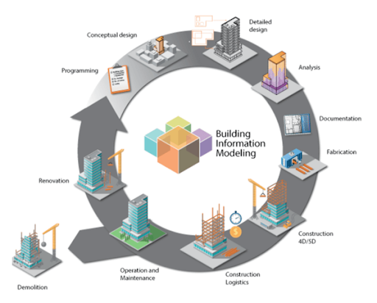
SECTION A: BIM EXECUTION PLAN OVERVIEW
WHAT IS THE BIM EXECUTION PLAN?
Building Information Modeling (BIM) is the process of creating and managing information about a construction project throughout its entire lifecycle. In other words, BIM is basically a different way of creating, using and sharing building lifecycle data [1].
Figure 1: What is BIM? What does it do? (URL-1)
BLOCK IV

Slide 5
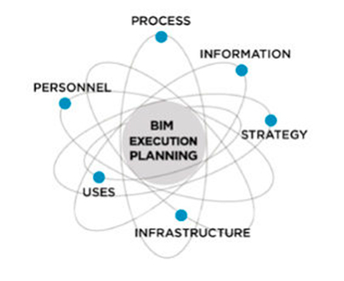
SECTION A: BIM EXECUTION PLAN OVERVIEW
WHAT IS THE BIM EXECUTION PLAN?
BIM Execution Plan is a plan that defines the objectives of implementing BIM technology in a project. Explains how to apply the created model, explains the application processes and ways of information exchange. It also contains information about all the project infrastructure necessary for a successful BIM implementation, namely the technologies we will implement, the team responsible for the implementation, and the contracts to be fulfilled [2].
Figure 2: BIM Community The BIM Execution Plan (URL-2)
BLOCK IV

Slide 6
SECTION A: BIM EXECUTION PLAN OVERVIEW
WHAT IS THE BIM EXECUTION PLAN?
It should be noted that there is no universal BIM application method for every project. Each team should effectively design a well-tailored BEP implementation strategy. Therefore, only the team that understands the project's goals, characteristics and capabilities of its members can effectively implement BIM in the project. After creating the plan, the team should monitor progress against the plan. Continuously developing, updating and correcting the plan at every stage of the project is crucial to obtain maximum benefit from BIM implementation [2].
BLOCK IV

Slide 7
SECTION A: BIM EXECUTION PLAN OVERVIEW
WHY IS THE BIM EXECUTION PLAN DONE?
One way to streamline the BIM implementation process on a project in an organized and efficient way is to create a BIM Execution Plan (BEP) before starting the design phase[1].
Figure 3: (URL-3)
BLOCK IV

Slide 8
SECTION A: BIM EXECUTION PLAN OVERVIEW
WHY IS THE BIM EXECUTION PLAN DONE?
The BEP is a procedural process that outlines the overall vision of the project with implementation details for the project team to follow throughout the project. It also helps the employer and project members document the BIM deliverables and processes agreed for the project and defines roles and responsibilities for each of these deliverables [3].
By increasing the level of planning, the number of uncertainties in the implementation process is reduced and thus the overall risk for all parties involved in the project is reduced [2].
BLOCK IV

Slide 9
SECTION A: BIM EXECUTION PLAN OVERVIEW
BIM EXECUTION PLAN COMPONENTS
BEP; It should express the scope of BIM implementation, the process flow for BIM tasks, and information exchange between parties, as well as describe the project and company infrastructure necessary to support implementation[4].
Defining project information,
Determining the project BIM targets,
Choosing BIM uses,
Creating a BIM process,
Defining how to exchange information,
Choosing the right infrastructure.
BLOCK IV

Slide 10
SECTION B
PROJECT INFORMATION
BLOCK IV

Slide 11
SECTION B: PROJECT INFORMATION
This section; It is the section that contains information about the project such as the name of the project, the owner of the project, the short project description, the stages of the project.
PROJECT OWNER
PROJECT NUMBER
PROJECT NAME
PROJECT LOCATION AND ADDRESS
BRIEF PROJECT DESCRIPTION
PROJECT SCHEDULE / PHASES
BLOCK IV

Slide 12
SECTION B: PROJECT INFORMATION
Necessary information can be given as in Table 1.
BLOCK IV

Slide 13
SECTION B: PROJECT INFORMATION
In addition, when each stage in the project will start and when it will end should be indicated with a table.
BLOCK IV

Slide 14
SECTION C
PROJECT GOALS / BIM USES
BLOCK IV

Slide 15
SECTION C: PROJECT GOALS / BIM USES
MAJOR BIM GOALS / OBJECTIVES
The second step in creating an effective BIM Execution Plan is to consider the benefits that BIM can bring to our project and to define the goals we aim to achieve on this basis. To effectively define goals, such goals must be relevant to the project being created, measurable, and achievable for the project team.
BLOCK IV

Slide 16
SECTION C: PROJECT GOALS / BIM USES
MAJOR BIM GOALS / OBJECTIVES
In addition, since the objectives of the BEP will vary depending on the project characteristics, they should be considered separately for each project .
The objectives of the project can be given in a table.
BLOCK IV

Slide 17
SECTION C: PROJECT GOALS / BIM USES
MAJOR BIM GOALS / OBJECTIVES
The table may also include potential BIM Uses.
BLOCK IV

Slide 18
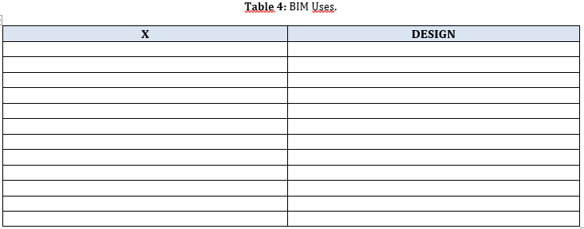
SECTION C: PROJECT GOALS / BIM USES
BIM USES
When choosing BIM uses, we need to consider our goals for the project and the results we want. We include the BIM uses we have determined in this section by marking them in the table.
BLOCK IV

Slide 19
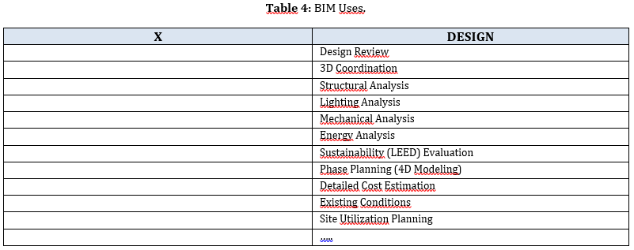
SECTION C: PROJECT GOALS / BIM USES
BIM USES
BIM usages in the table are written as an example.
BLOCK IV

Slide 20
SECTION D
ORGANIZATIONAL ROLES / STAFFING
BLOCK IV

Slide 21
SECTION D: ORGANIZATIONAL ROLES / STAFFING
PROJECT NAME
MECHANICAL ENGİNEERS
(ME)
CONSTRUCTION MANAGERS
(CM)
STRUCTURAL ENGİNEERS
(SE)
LIGHTING/ ELECTRICAL ENGINEERS
(LE)
Figure 4 shows the synthesis of individual disciplines and multidisciplinary integration. This section defines the roles and responsibilities of team members. These teams should consist of technical staff experienced in BIM modeling tools in their fields of expertise (architectural, structural, mechanical, electrical, etc.). It differs for each project. It is organized according to the disciplines that should be in the project team.
The tasks of each expert within the scope of the project should be defined in articles.
Figure 4: Project Team.
BLOCK IV

Slide 22
SECTION D: ORGANIZATIONAL ROLES / STAFFING
Construction Manager
BIM Execution Plan
Site Investigation
Constructability Input
Preliminary Estimate
Preliminary Schedule
Final Estimate
Final Schedule
4D Modelling
Structural Engineer
Geotechnical Report
Preliminary Base Model
Structural Systems Options
Structural System Selection
Preliminary Structural System Design
Final Structural System Design
This figure displays the individual disciplines’ specific tasks.
The center circle shows the synthesis of multidisciplinary integration.
Multidisciplinary Integration
Mechanical Engineer
Mechanical System Options
Mechanical System Space Requirements
Mechanical System Selection
Preliminary Mechanical System Design
Final Mechanical Design
Lighting/ Electirical
Engineer
Daylighting Options
Lighting/Electirical System Selection
Preliminary System Design
Site Lighting Design
Energy Model Review
Final Electirical Design
Update Energy Model
Figure 5: Organizational Roles and Responsibilities.
BLOCK IV

Slide 23
SECTION E
BIM PROCESS AND STRATEGY
BLOCK IV

Slide 24
SECTION E: BIM PROCESS AND STRATEGY
In this section, “Team Process Overview Map” and “Detailed Team Member Process Map” are prepared.
A process map is a planning and management tool that visually describes the flow of work.
The Process Map template is a valuable tool for documenting, analyzing, and better understanding your project team's business processes and associated results.
The Process Map template should be organized according to stages, which you can use to record the goals, activities and outputs of each stage in your project process.
It enables you to improve your team's organization, productivity and communication by reaching a common understanding of all kinds of processes.
BLOCK IV

Slide 25
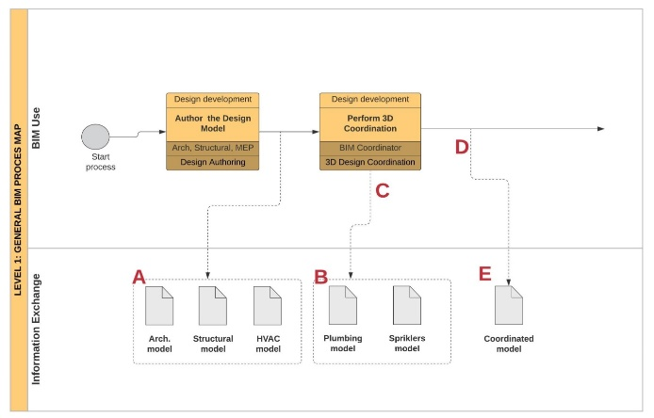
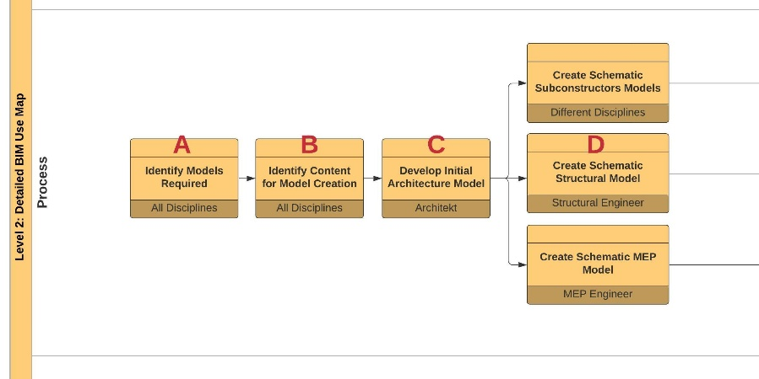
SECTION E: BIM PROCESS AND STRATEGY
Sample process maps prepared in studies in the literature.
Figure 6: BIM Process Map (5).
Figure 7: BIM Use Map (5).
BLOCK IV

Slide 26
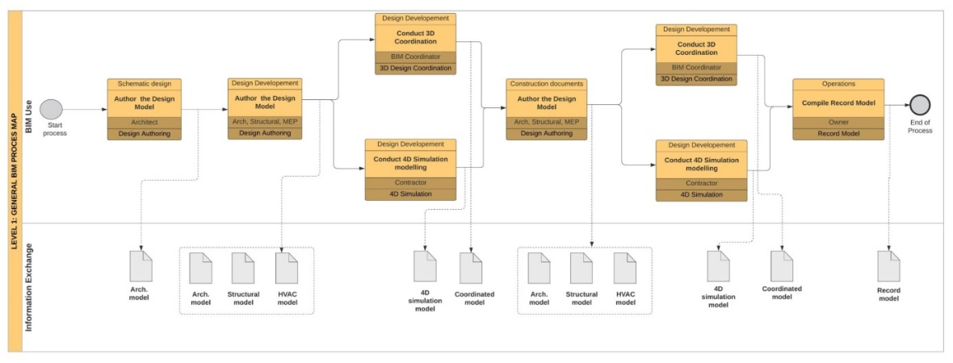
SECTION E: BIM PROCESS AND STRATEGY
Sample process maps prepared in studies in the literature.
Figure 8: BIM Process Map (5).
BLOCK IV

Slide 27
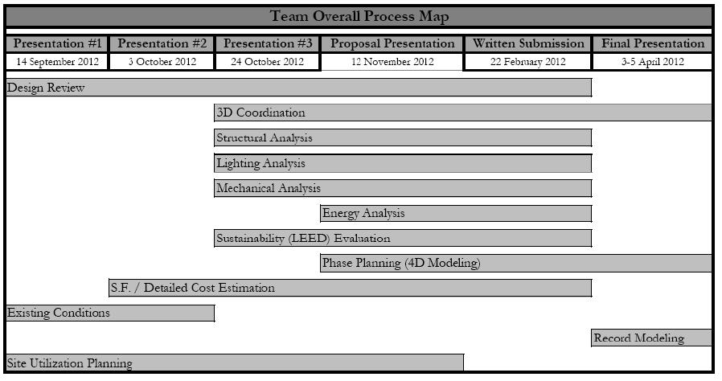
SECTION E: BIM PROCESS AND STRATEGY
Sample process maps prepared in studies in the literature.
Figure 9: Team Overall Process Map (6).
BLOCK IV

Slide 28
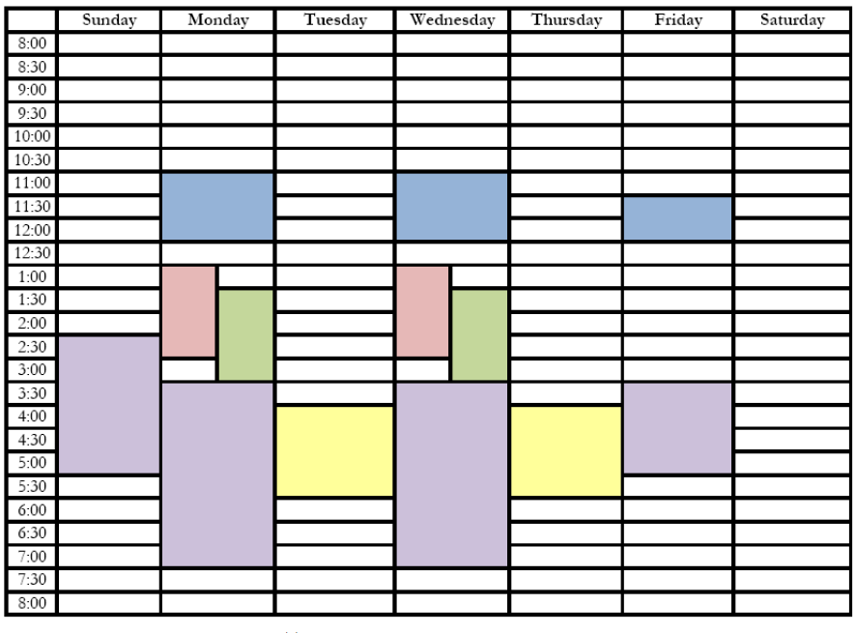
SECTION E: BIM PROCESS AND STRATEGY
Sample process maps prepared in studies in the literature.
The sample table shows the common meeting times for all team members shown in purple for the integration of BIM outputs. Other tones indicate individual discipline meeting times.
All Team Members
Construction Managers
Structural Engineers
Mechanical Engineers
Lighting/ Electirical Engineers
Figure 10: Weekly Meeting Schedule (6).
BLOCK IV

Slide 29
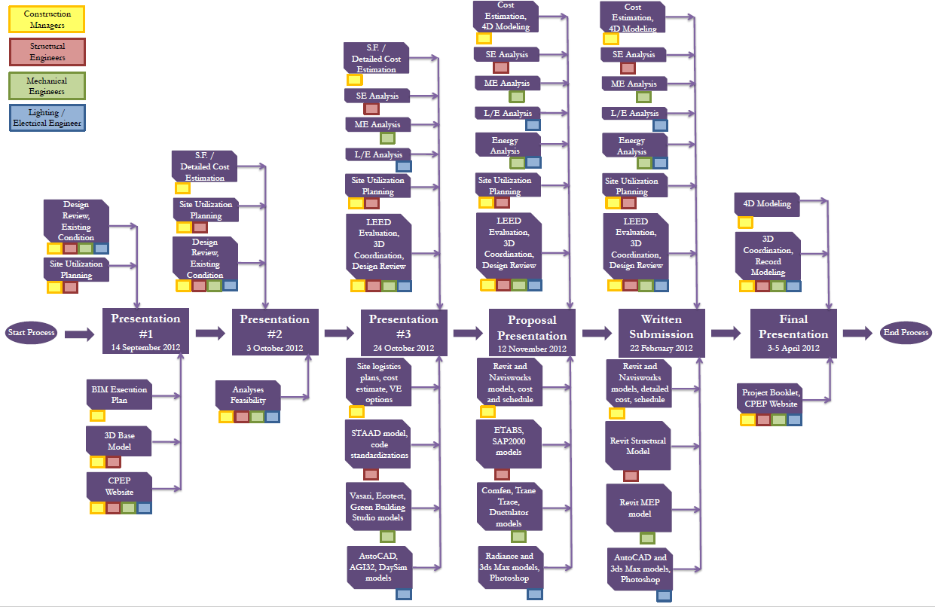
SECTION E: BIM PROCESS AND STRATEGY
Sample process maps prepared in studies in the literature.
Construction Managers
Structural Engineers
Figure 11: :Team General Process Map (6).
Mechanical Engineers
Lighting/ Electirical Engineers
BLOCK IV

Slide 30
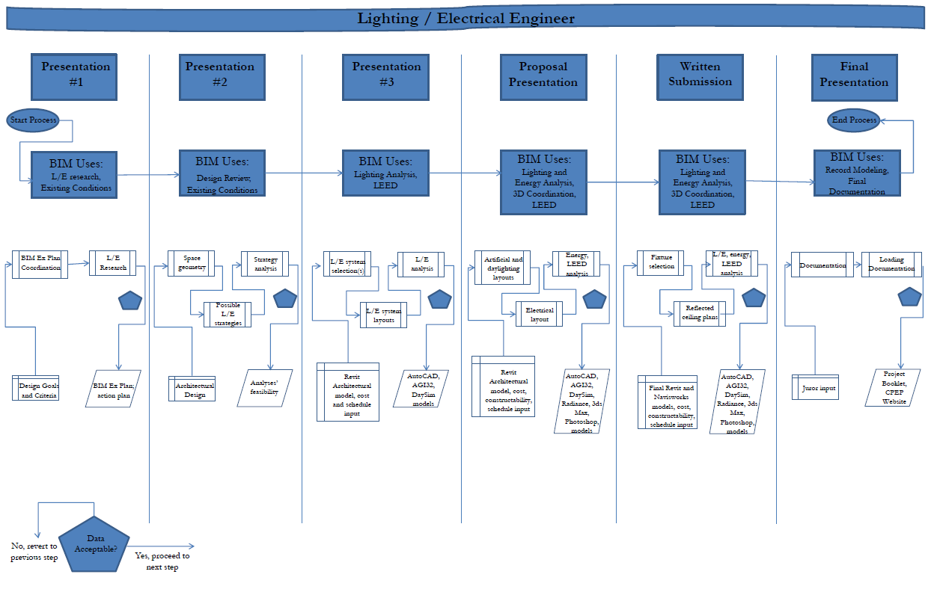
SECTION E: BIM PROCESS AND STRATEGY
Sample process maps prepared in studies in the literature.
Figure 12: :Lighting/ Electrical Engineer General Process Map (6).
BLOCK IV

Slide 31
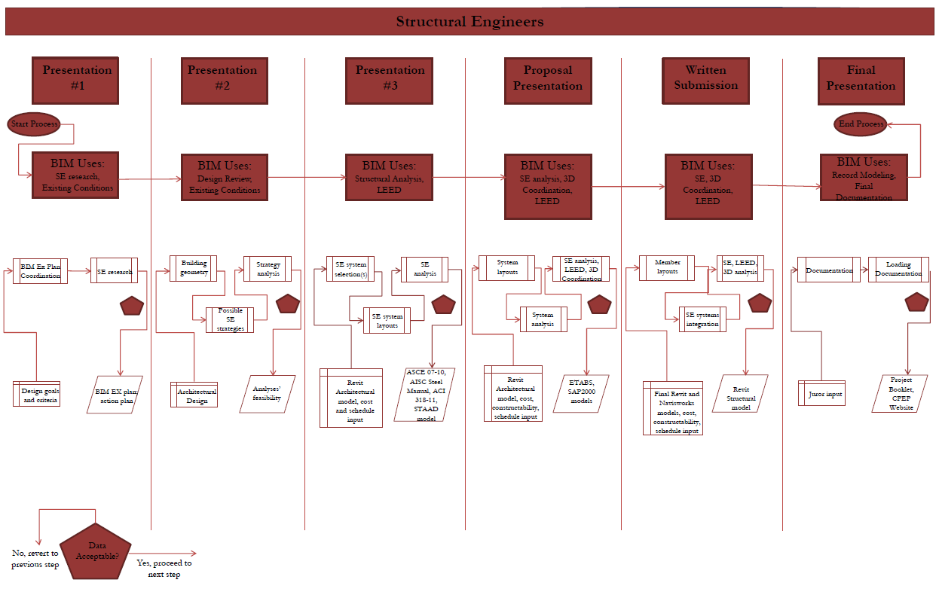
SECTION E: BIM PROCESS AND STRATEGY
Sample process maps prepared in studies in the literature.
Figure 13: :Structural Engineer General Process Map (6).
BLOCK IV

Slide 32
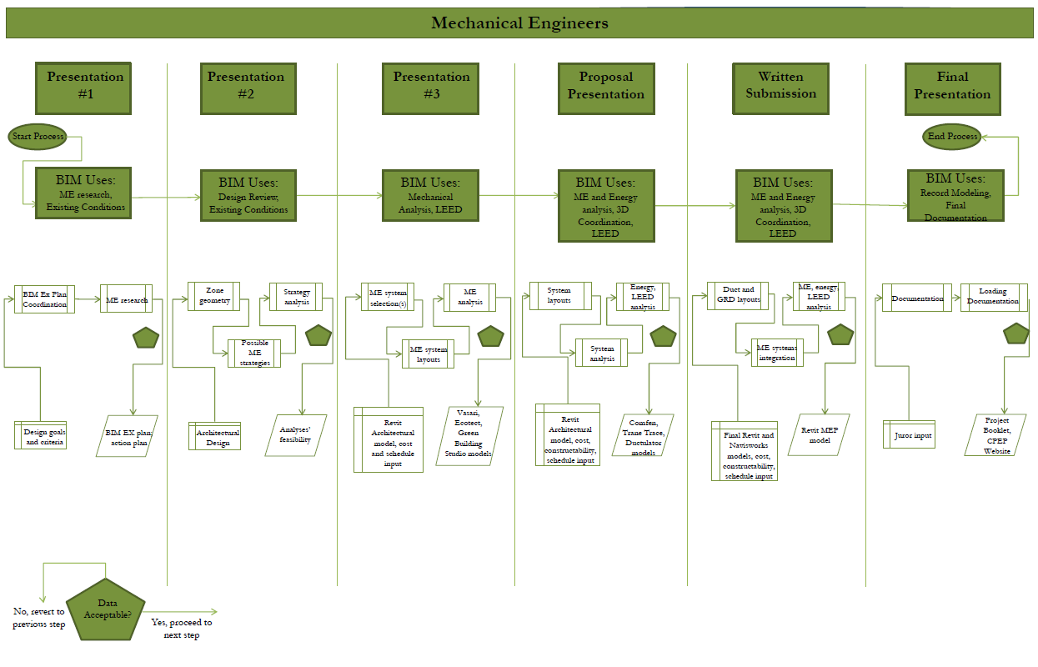
SECTION E: BIM PROCESS AND STRATEGY
Sample process maps prepared in studies in the literature.
Figure 14: :Mechanical Engineer General Process Map (6).
BLOCK IV

Slide 33
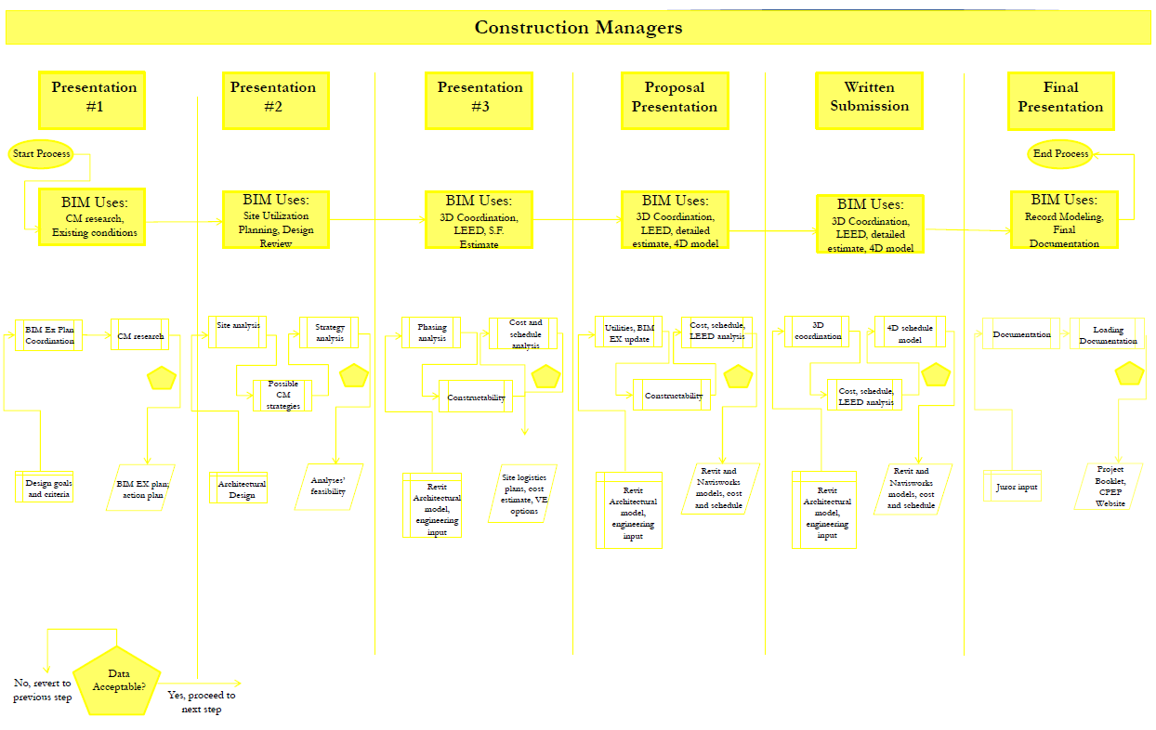
SECTION E: BIM PROCESS AND STRATEGY
Sample process maps prepared in studies in the literature.
Figure 15: :Construction Manager General Process Map (6).
BLOCK IV

Slide 34
SECTION F
BIM EXCHANGE PROTOCOL AND SUBMITTAL FORMAT
BLOCK IV

Slide 35
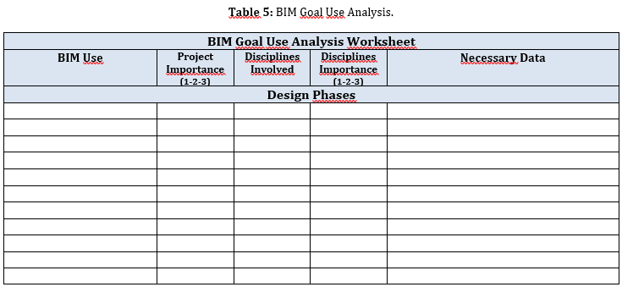
SECTION F: BIM EXCHANGE PROTOCOL AND SUBMITTAL FORMAT
This section describes each of the team's uses of BIM and the result of each (Table 4). With the Team General Process Map, the duration of each BIM use is summarized according to the stages (Table 5). In addition, the files to be delivered are determined in which format (pdf, dwg, etc.) the 2D layouts will be presented, as well as the original program formats in which the data were prepared.
BLOCK IV

Slide 36
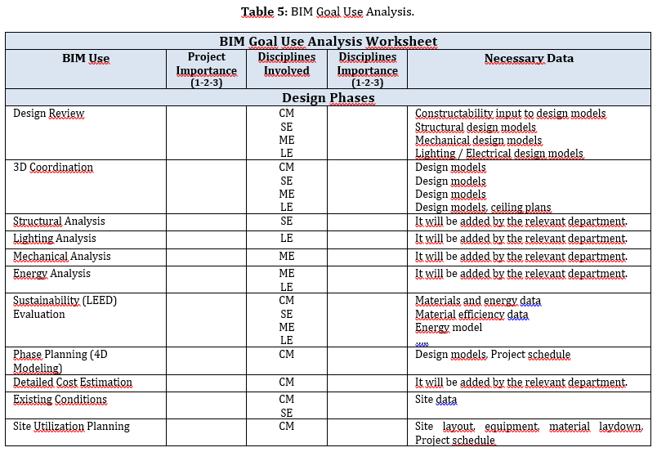
SECTION F: BIM EXCHANGE PROTOCOL AND SUBMITTAL FORMAT
BIM usages in the table are written as an example.
BLOCK IV

Slide 37
SECTION G
BIM DATA REQUIREMENT
BLOCK IV

Slide 38
SECTION G: BIM DATA REQUIREMENT
This Data Environment is a common database for all project information and documents. It allows sharing of projects and technical documents and controlling their revisions, tracking all correspondence on a common system and sharing data. All project documents (2D drawings, quantity studies, etc.) to be prepared within the scope of BIM processes must be produced in accordance with the Common Data Environment (Project Management System).
BLOCK IV

Slide 39
SECTION H
COLLABORATION PROCEDURES AND METHOD TO HANDLE SHARED MODELS
BLOCK IV

Slide 40
SECTION H: COLLABORATION PROCEDURES AND METHOD TO HANDLE SHARED MODELS
COLLABORATION STRATEGY
This section should include the following.
Weekly meeting schedule – time
Team communication – Google Docs, common file storage
Continual interdisciplinary interaction for building systems’ integration
Team leaders selected based on project phase
Meeting minutes issued and discussed after each meeting to accomplish team objectives by next meeting date.
BLOCK IV

Slide 41
SECTION H: COLLABORATION PROCEDURES AND METHOD TO HANDLE SHARED MODELS
DISCIPLINE MODEL REQUIREMENTS
In the BIM Implementation Plan, mandatory information requirements are defined depending on the scope of the Project. These;.
Architectural Model Requirements
Structural Model Requirements
Mechanical Model Requirements
Electrical and Electronic Model Requirements
BLOCK IV

Slide 42
SECTION H: COLLABORATION PROCEDURES AND METHOD TO HANDLE SHARED MODELS
DISCIPLINE MODEL REQUIREMENTS
Architectural Model Requirements: Doors, windows, elevators, escalators, screens, turnstiles, furniture, lighting elements, routing elements, MEP equipment, etc. It is defined which information will be given for all building elements and all materials used.
Figure 16: (URL-4)
BLOCK IV

Slide 43
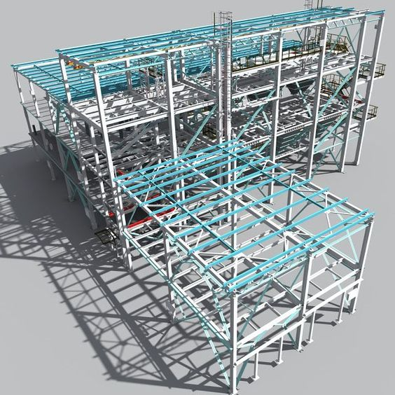
SECTION H: COLLABORATION PROCEDURES AND METHOD TO HANDLE SHARED MODELS
DISCIPLINE MODEL REQUIREMENTS
Structural Model Requirements: Reservations on vertical/horizontal circulation elements, all shafts, spaces, stairs, carrier elements are processed into the BIM model with their brief explanations.
Figure 17: (URL-5)
BLOCK IV

Slide 44
SECTION H: COLLABORATION PROCEDURES AND METHOD TO HANDLE SHARED MODELS
DISCIPLINE MODEL REQUIREMENTS
Mechanical Model Requirements: The width, height and height information of the elements of the systems are modeled as 3D parametric.
Figure 18: (URL-6)
BLOCK IV

Slide 45
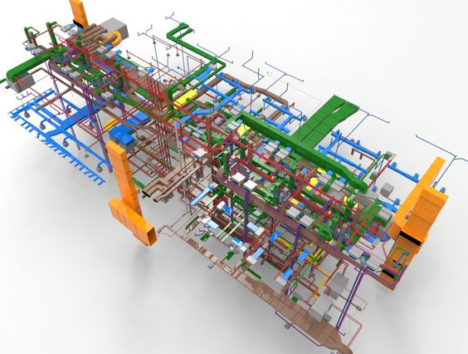
SECTION H: COLLABORATION PROCEDURES AND METHOD TO HANDLE SHARED MODELS
DISCIPLINE MODEL REQUIREMENTS
Electrical and Electronic Model Requirements: All generators, transformers, cable trays, fixtures, switches, sockets, announcements, telephones, passenger information screens, card readers, detectors, etc. in the project. Medium voltage, Direct voltage and Low voltage etc. The main equipment of all systems are shown in the model.
Figure 19: (URL-7)
BLOCK IV

Slide 46
SECTION I
QUALITY CONTROL
BLOCK IV

Slide 47
SECTION I: QUALITY CONTROL
The project owner is responsible for the quality of all models to be presented. First, the disciplines should check the model quality within themselves. The BIM manager is responsible for controlling the quality of the model, taking into account the coordination of all disciplines, within the framework of its defined responsibilities. In this section, checklists are first created within the scope of the BIM Execution Plan and models are evaluated according to this list.
BLOCK IV

Slide 48
SECTION J
TECHNOLOGY INFRASTRUCTURE & SOFTWARE
BLOCK IV

Slide 49
SECTION J: TECHNOLOGY INFRASTRUCTURE & SOFTWARE
In this section, the provision of a cloud system or main server, the installation of infrastructure that provides instant access to all projects, and the installation of the infrastructure, and the hardware features of the system are determined.
In addition, in order to avoid the problem of opening the models between the Designer and the Manufacturer, which is not possible due to the revision difference during the project, which version of the same software the Designer and the Manufacturer (Consultant/Administration, Contractor, Sub-contractors, etc.) will use is determined at the beginning of the work and explained in this section. When an update is required, for which software, how and under whose responsibility (Designer/Manufacturer) the software will be updated is described in the BIM Implementation Plan.
BLOCK IV

Slide 50
REFERENCES
J. A. Ramírez-Sáenz, J. M. Gómez-Sánchez, J. L. Ponz-Tienda, J. P. Romero-Cortés and L. Gutiérrez-Bucheli, (2018). “Requirements For a BIM Execution Plan (BEP): A Proposal For Application in Colombia”. Building & Management, vol. 2(2), pp. 05-14.
Lozinski, I. (2020). “Creating a successful BIM Execution Plan: Part 1”, https://bimcorner.com/creating-a-successful-bim-execution-plan-part-1/ (erişim tarihi: 07.07.2021).
Building and Construction Authority, (2013). “Singapore BIM Guide - V2.0,” Cornet, pp. 1–70.
Hrdina, O., Matějka, P., (2016). “Bım Execution Plan in Czech Republic”. journal Business & IT, 2, pp:17-23.
Lozinski, I. (2020). “Creating Successful BIM Execution Plan. Part 3: Design A BIM Process”, https://bimcorner.com/creating-successful-bim-execution-plan-part-3-design-a-bim-process/ . (erişim tarihi: 07.07.2021).
Byard, A. & LaChance, B. (2012). “ Building Information Modeling Project Execution Plan”, …..
URL1: https://www.google.com/search?q=building+information+modelling&tbm=isch&ved=2ahUKEwi5sa2Tkov0AhXLxrsIHTc1ATYQ2-cCegQIABAA&oq=BU%C4%B0LD%C4%B0NG+%C4%B0NFORMAT%C4%B0ON+MODELL%C4%B0NG&gs_lcp=CgNpbWcQARgAMgcIIxDvAxAnMgUIABCABDIGCAAQBxAeMgYIABAHEB4yBggAEAcQHjIECAAQHjIECAAQHlAAWABg1w1oAHAAeACAAZYBiAGWAZIBAzAuMZgBAKoBC2d3cy13aXotaW1nwAEB&sclient=img&ei=w1aKYfnDKcuN7_UPt-qEsAM&bih=912&biw=1920&rlz=1C1EJFC_enTR844TR844#imgrc=7HPwvz9GqsSITM
URL2:https://www.google.com/search?q=bim+execution+plan&rlz=1C1EJFC_enTR844TR844&sxsrf=AOaemvLeGPjhlRCwkXATjnIpiBSTw3B94g:1636456425769&source=lnms&tbm=isch&sa=X&sqi=2&ved=2ahUKEwi2xMqfk4v0AhW7kWoFHWJIDfAQ_AUoAXoECAEQAw&biw=1920&bih=912&dpr=1#imgrc=Yxmh1NPVdhtmAM
URL3: https://tr.pinterest.com/pin/785033778792647997/
URL4: https://tr.pinterest.com/pin/367113807132555563/
URL5: https://tr.pinterest.com/pin/672091944396019969/
URL6: https://tr.pinterest.com/pin/172614598208917741/
URL7: https://tr.pinterest.com/pin/772648879820699523/
BLOCK IV

